Slide 1
Prepare a sketch
Characters:
1. Martin Luther: critizising the church and burning the bull of excommunication
2.JohnTetzel: selling indulgences
3.The Pope Leo X: asking Luther to recant and sending the bull.
4.The people: afraid of going to hell
5. The priests: bad behaviour

Slide 2
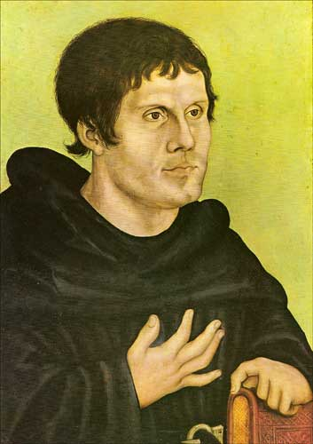
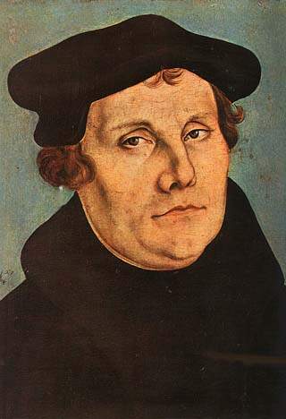
Martin Luther

Slide 3
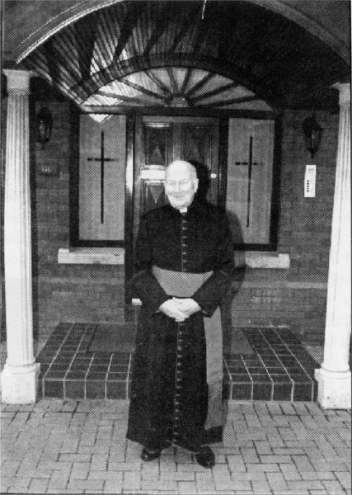
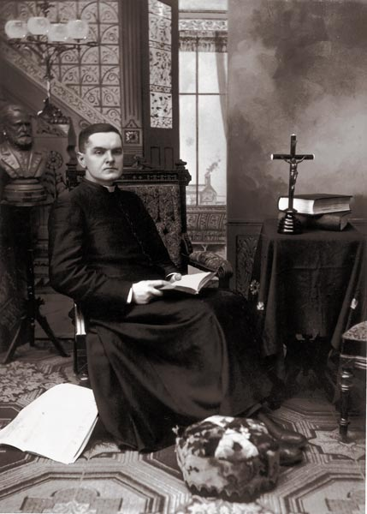
Parish priests

Slide 4
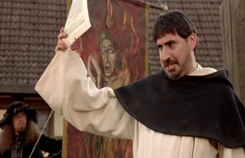
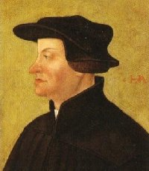
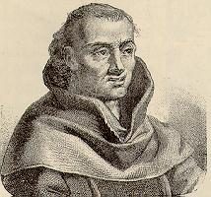
Selling indulgences
John Tetzel

Slide 5
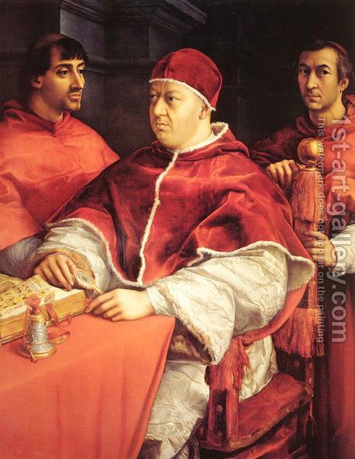
Pope Leo X

