Slide 1
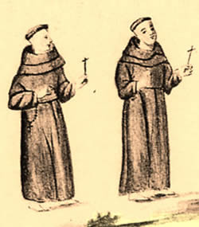
Parish Priests-1500s

Slide 2
c
D
B
A
POPE & ARCHBISHOP
He liva long day away

Slide 3
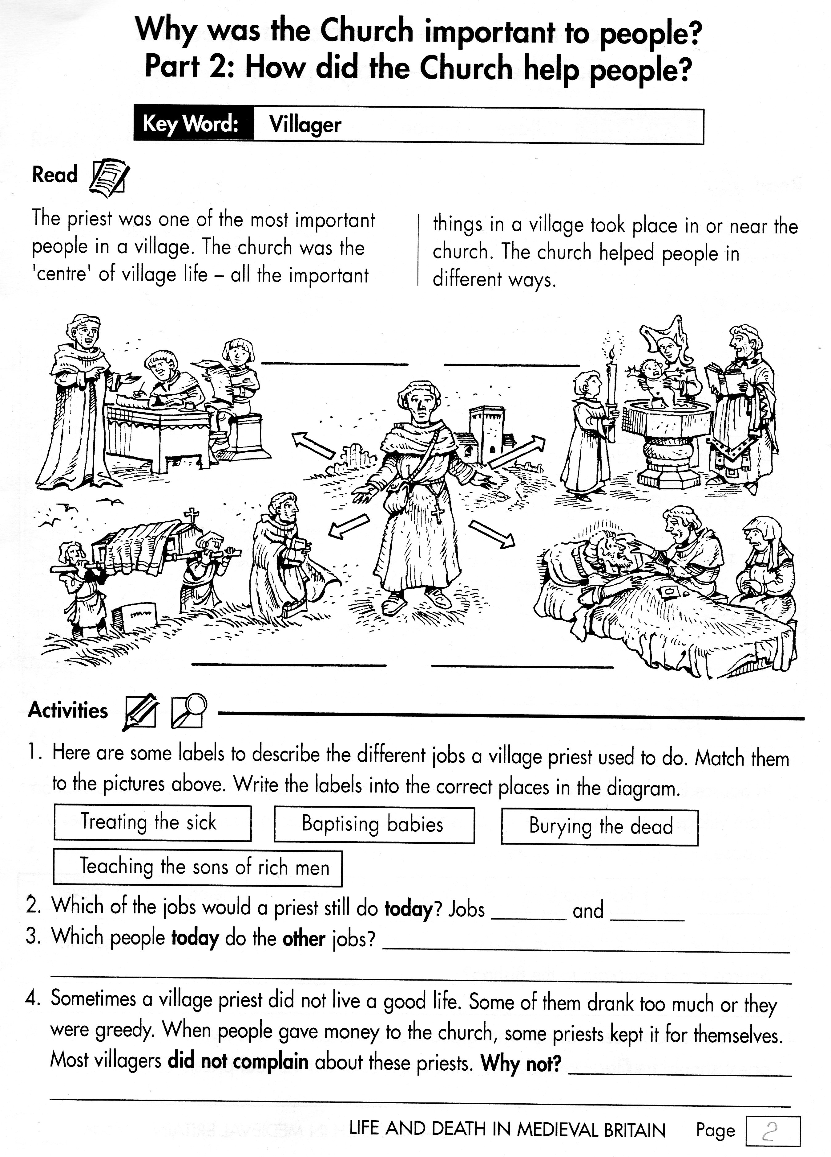

Slide 4
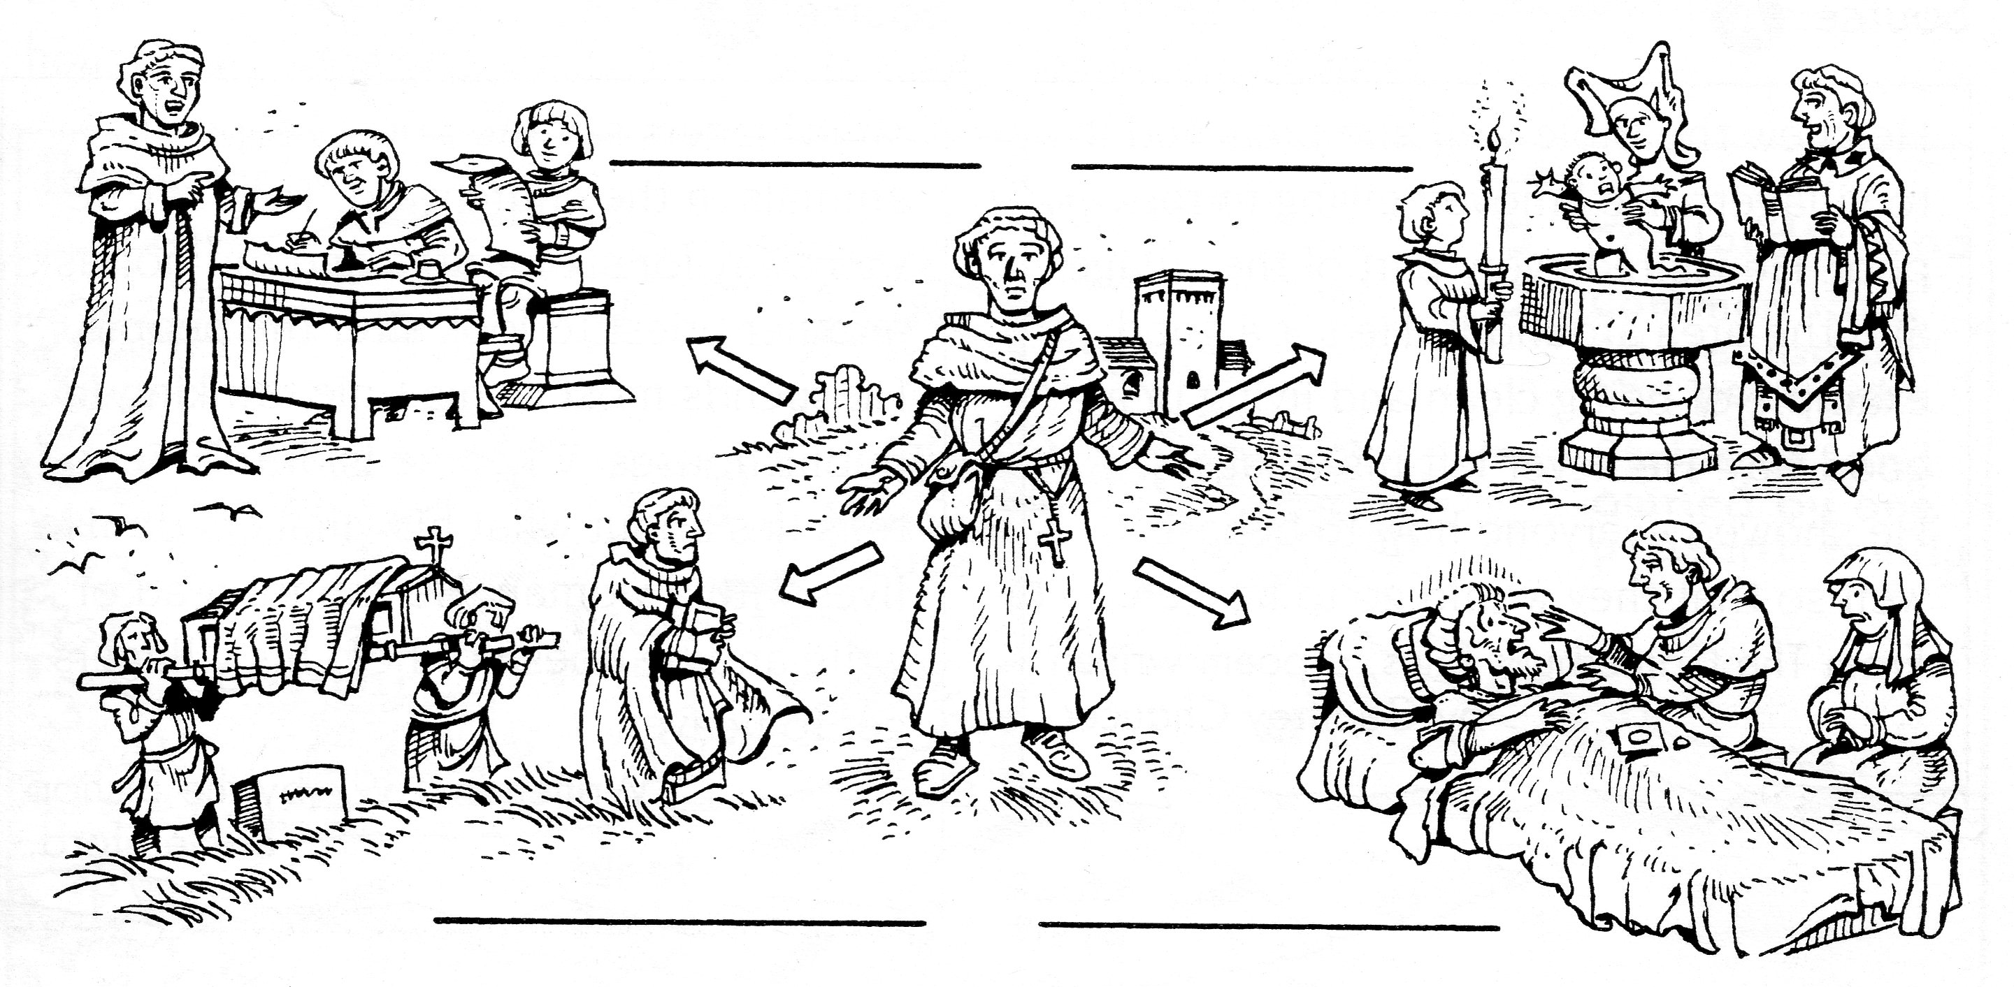
Good things to help people
MARRY PEOPLE
SAY MASS
What are the priests doing?

Slide 5
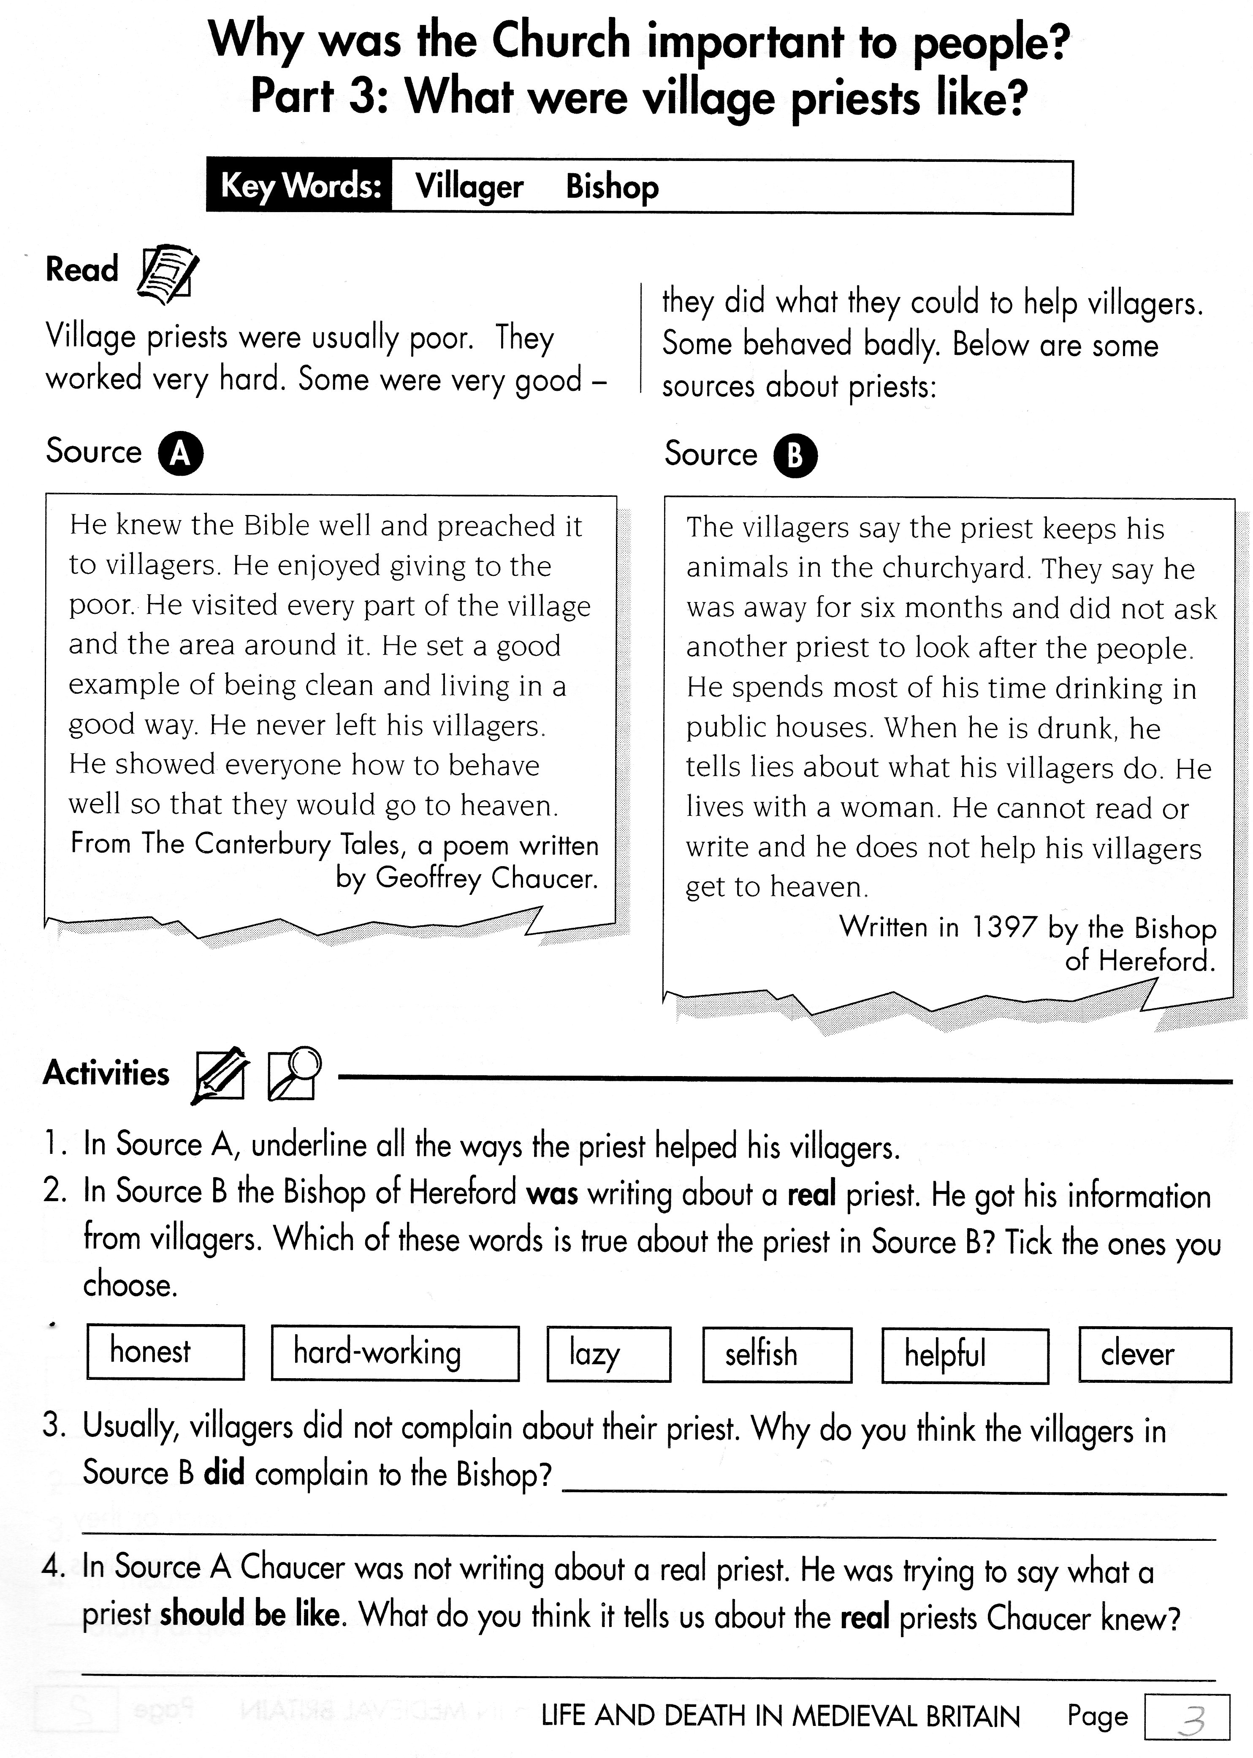

Slide 6
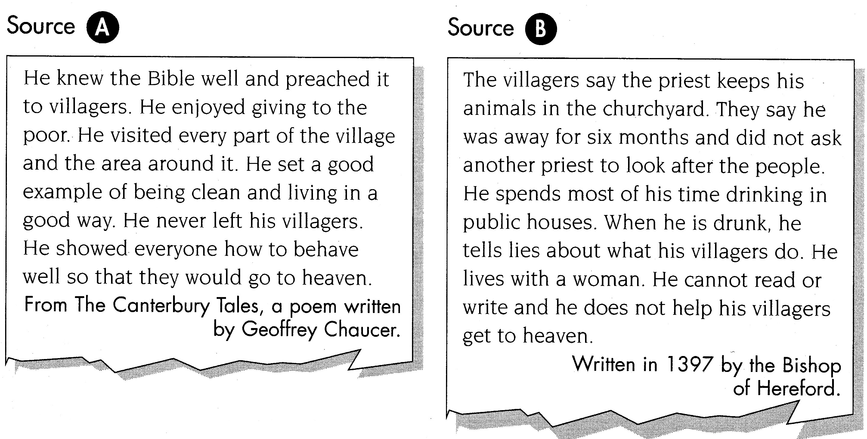
Some Sources about - What were priests like?
BUT…
What do you think?

Slide 7
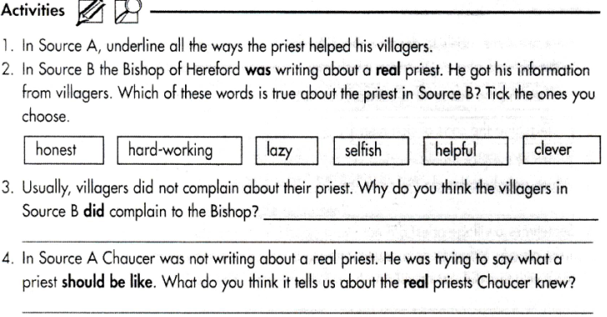
or highlight

