Slide 1
Draw a comic strip

Slide 2
Usually there are several panels within a comic strip... usually outlined separately to divide one scene from another and show the action continuing.

Slide 4
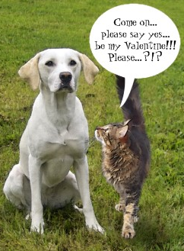
Speech bubbles

Slide 6
